Slide 1

ANALYZING NUTRITIONAL INFORMATION OF STARBUCKS MENU ITEMS
AIT-664-DL2, Prof Dr Ebrima Ceesay
TEAM 3
DIVYA NALLURI
SNEHITA VATTAMWAR

Slide 2
INTRODUCTION
Starbucks, being a Seattle-based global leader in the coffee marketplace, has everything from a multi-taste Frappuccinos® to a simple classic espresso and iced selection. With increased awareness of health concerns, there has come an increased demand for transparent information on nutrition, especially in diet-related health issues like obesity and diabetes. Even if Starbucks is providing nutritional information, there is no clarity on how customers can make choices to lead towards better health goals. This presentation highlights the necessity for Starbucks to increase the transparency level, providing exact nutritional analysis to close the understanding gap that can further promote healthier choices for customers.

Slide 3
PROBLEM STATEMENT
Despite providing nutritional information, a significant gap remains in how this data is understood.
Limited Consumer Guidance: Many lack the tools to interpret nutritional effectively, hindering informed choices.
Health Concerns: Rising diet-related health issues mean consumers need comprehensive analysis to make health-conscious decisions.
Corporate Responsibility: As nutrition awareness grows, Starbucks must offer transparent data to maintain trust and loyalty.

Slide 4
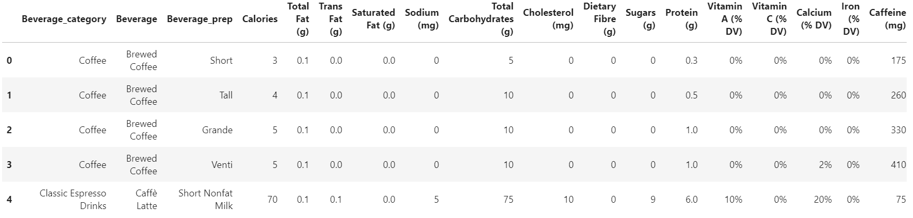
DATASET OVERVIEW
starbucks-menu-nutrition-drinks

Slide 5
PROPOSED APPROACH
We obtained the "starbucks_drinkMenu_expanded.csv" dataset from Data.world and thoroughly cleaned and standardized it, prioritizing nutritional factors like calorie count, fat percentage, sugar level, and caffeine content. Initial exploration involved generating statistical summaries and crafting visual aids to identify patterns and anomalies. Beverages were categorized based on calorie and sugar benchmarks, revealing trends in high-sugar and high-calorie items. Advanced correlation analysis pinpointed influential nutritional elements, visualized through heatmaps and scatter plots. Insights were then translated into educational material to guide informed choices. An interactive digital tool was prototyped, allowing users to filter and sort beverages based on nutritional preferences. User feedback refined the interface, and the tool was integrated into Starbucks' digital channels for a personalized browsing experience.

Slide 6
RELATED WORK

Slide 7
Bollinger et al.
Objective: Examine calorie posting effects at Starbucks, NYC.
Outcome: 6% drop in calories per transaction; no revenue loss.
Huang et al.
Focus: Caloric content of beverages at Starbucks and Dunkin' Donuts.
Key Insight: High calorie count in blended coffee drinks.
Wu's Analysis:
Aim: Identify nutritious drink options for CVD prevention.
Method: Health index via principal component analysis.

Slide 8
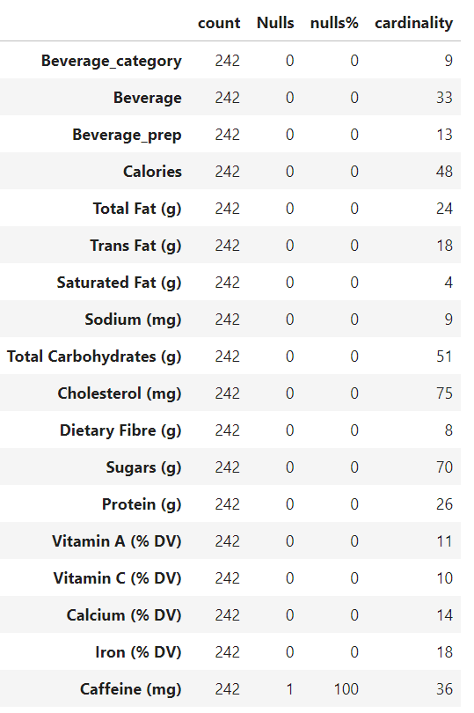
Attribute corresponding null values
The figure is a table summarizing statistical data on 242 beverages, including attributes like calories, fats, vitamins, and minerals. Most categories have no null values, except for caffeine, which has one null entry. The 'cardinality' values reflect the variety in beverage types, preparations, and nutritional content.

Slide 9
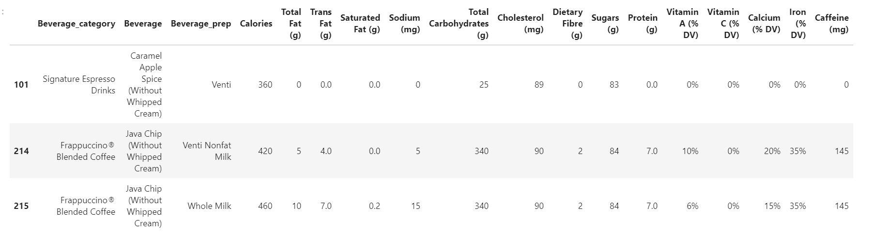
Table displaying the beverage having at least 80 gm of sugars
The figure presents a table of beverages with over 80 grams of sugar. It includes "Caramel Apple Spice (Without Whipped Cream)" and two "Java Chip Frappuccino® Blended Coffee" variations, differing only by milk type (nonfat and whole milk). Each row provides detailed nutritional information, highlighting substantial variations in nutritional content based on minor recipe adjustments.

Slide 10
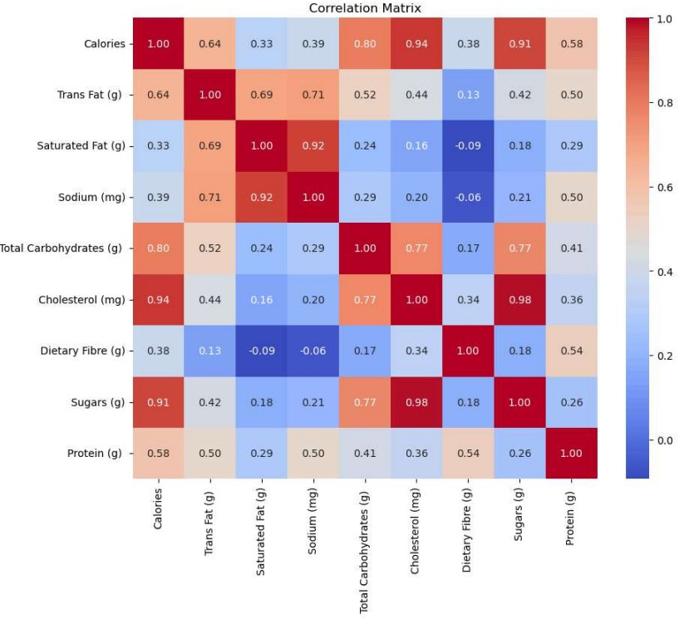
CORRELATION MATRIX
The figure shows a heatmap of correlations between nutritional components like calories, fiber, sugars, sodium, carbs, cholesterol, and fats. Positive correlations are in red, negative in blue, with intensity indicating strength. Perfect correlations (1) are along the diagonal where each variable correlates with itself.

Slide 11
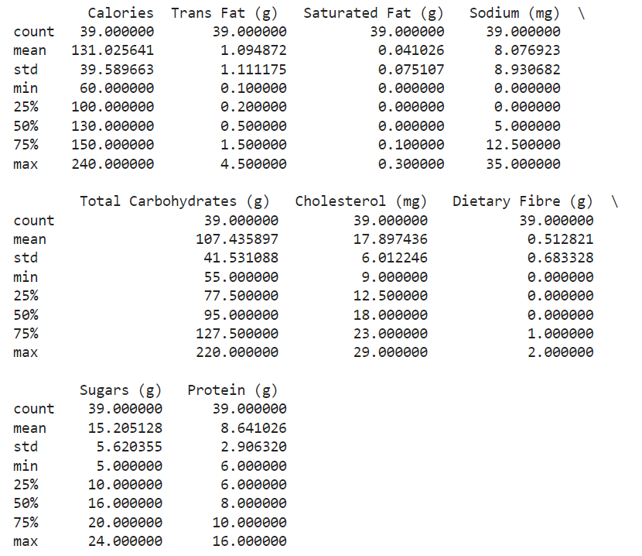
SUMMARY STATISTICS
Table depicts the summary of beverage having minimum 25 gm of sugars and atleast 5gms of protein
The figure presents a statistical summary of 39 Starbucks beverages with less than 25 grams of sugar and over 5 grams of protein. Key metrics include an average calorie count of 131.03, 15.20 grams of sugar, and 8.64 grams of protein per beverage. The maximum protein content is 16 grams, while sugar tops out at 24 grams, offering insight into beverages that are low in sugar but high in protein.

Slide 12
VISUALIZATIONS

Slide 13
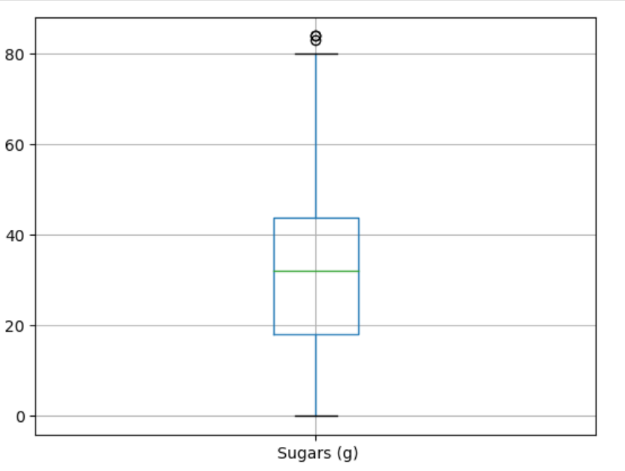
Table depicts the summary of beverage having minimum 25 gm of sugars and at least 5gms of protein
The figure shows a box plot of sugar content in Starbucks beverages. The median sugar content, indicated by the green line, is around 30 grams. The interquartile range (IQR) spans from 20 to 40 grams, with whiskers extending from about 10 to just over 60 grams. An outlier near 80 grams suggests an unusually high sugar content. This plot highlights the central tendency and variability of sugar content across the dataset.

Slide 14
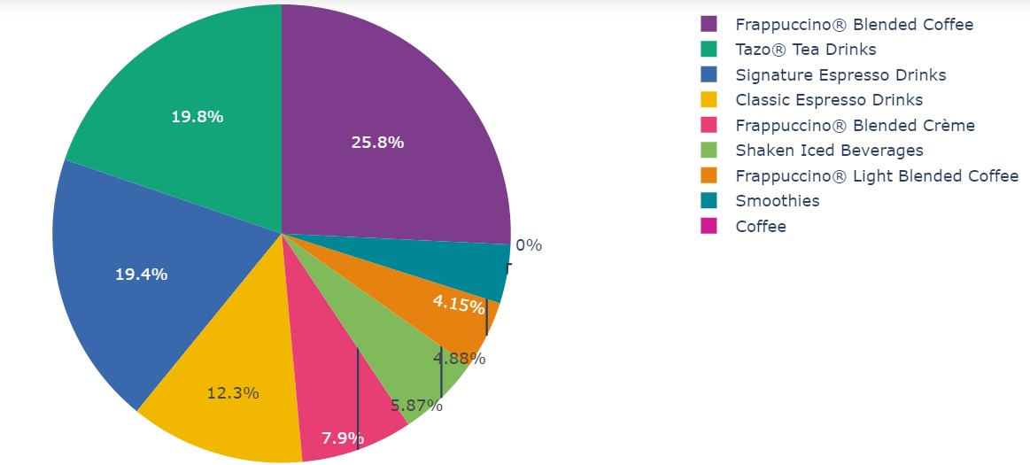
Distribution of Sugar Intake vs Beverage Category
The Figure shows a pie chart of beverage category distribution. Frappuccino® Blended Coffee leads with a 25.8% share, followed by Tazo® Tea Drinks at 19.8%. Other categories include Signature Espresso Drinks, Classic Espresso Drinks, Frappuccino® Light Blended Coffee, Shaken Iced Beverages, Smoothies, and Coffee, each represented by different shades for easy comparison.

Slide 15
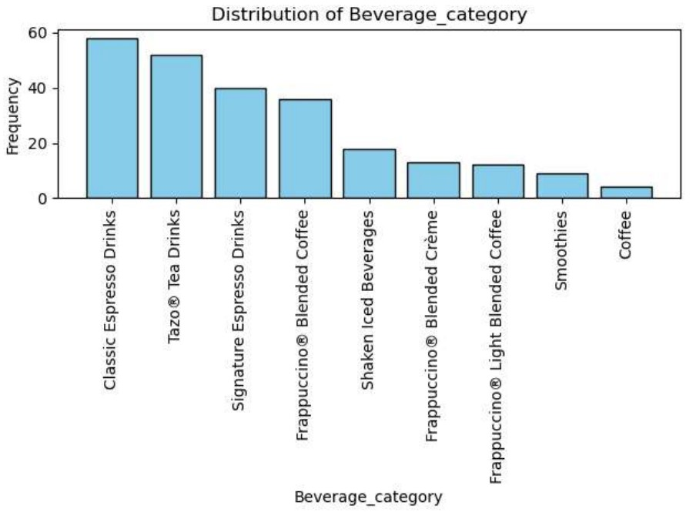
Distribution of Beverage Category
The bar chart shows beverage category distribution, with Classic Espresso Drinks leading, followed by Tazo® Tea Drinks and Brewed Tea Drinks. Other categories, like Signature Espresso Drinks and Frappuccinos®, have fewer entries, while "Other" has the fewest. This chart highlights the popularity and availability of various beverage types.

Slide 16
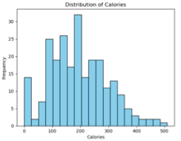
Distribution of Calories
The Figure displays the calorie distribution of Starbucks beverages. The x-axis shows calorie counts ranging from 0 to 500, while the y-axis reflects the number of observations in each range. Most items fall between 100 and 300 calories, peaking in the 200-250 calorie range. The distribution is unimodal, tapering off as calories approach 500.

Slide 17
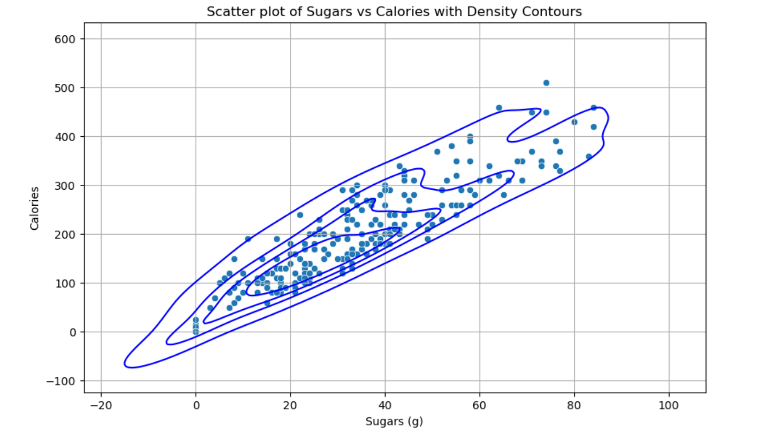
Relationship between sugar content and calories
The figure shows a scatter plot of Starbucks beverages, highlighting a positive correlation between sugar and caloric content. Most drinks cluster around moderate sugar and calorie levels, while a few outliers have significantly higher values.

Slide 18
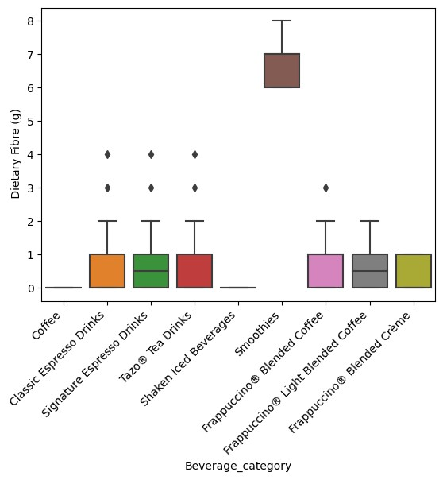
Dietary Fiber Content of Each Beverage Category
The Figure shows a box plot comparing the dietary fiber content across beverage categories. Tazo® Tea Drinks have the highest median fiber content, while other categories exhibit lower medians with varying distributions and outliers. The central line indicates the median, box edges represent the interquartile range, and whiskers extend to non-outlier points.

Slide 19
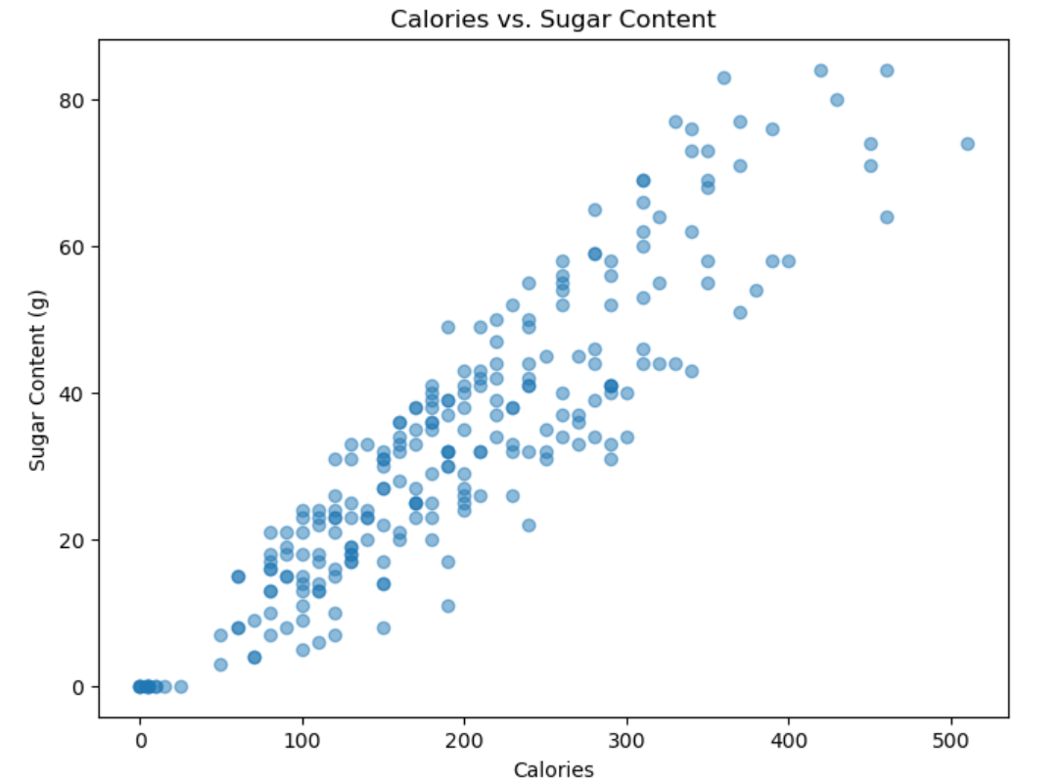
Relationship between Calories and Sugar Intake
The Figure shows a scatter plot of "Calories vs. Sugar Content," revealing a positive correlation between sugar and calorie content in beverages. Higher sugar levels generally correspond to higher calorie values.

Slide 20
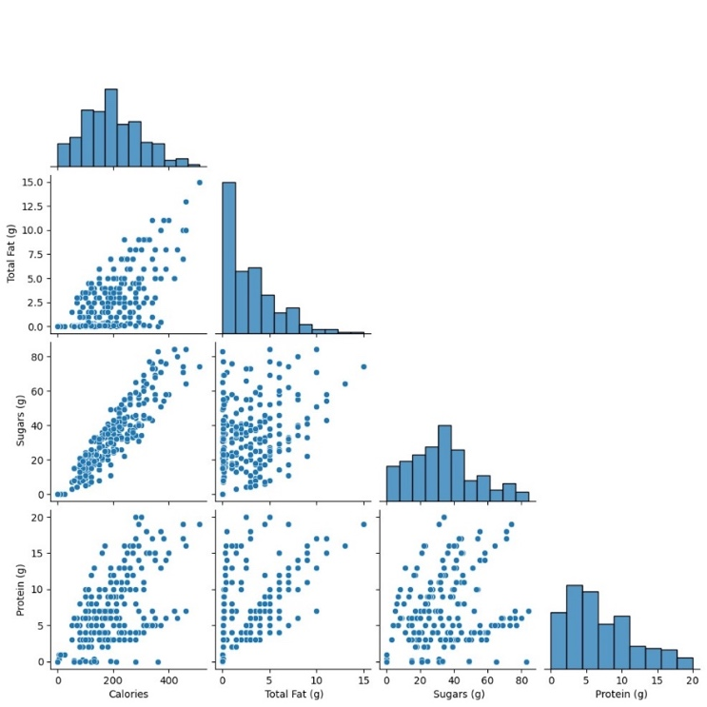
Pair Plot Correlational Analysis of Nutritional Metrics: Calorie, Total Fat, Sugar, & Protein
The Figure is a pair plot, or scatterplot matrix, illustrating relationships between nutritional elements: calories, total fat, carbohydrates, and protein. Diagonal plots show histograms of individual variables, while off-diagonal plots reveal scatter plots comparing pairs of variables. Notably, a positive relationship between calories and total fat suggests that total fat increases with calorie count. This visualization helps uncover potential relationships and distributions of continuous variables.

Slide 21
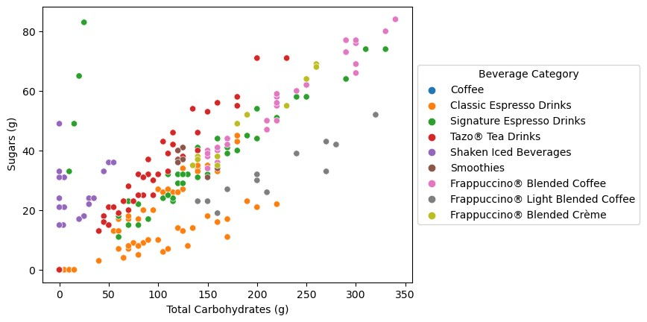
Scatter Plot for Total Carbohydrates vs. Sugars
The Figure shows the correlation between sugar content (grams) and total carbohydrates (grams) across various beverage categories. The positive correlation between sugar and total carbohydrates is clear, with varying sugar and carbohydrate content both within and between categories.

Slide 22
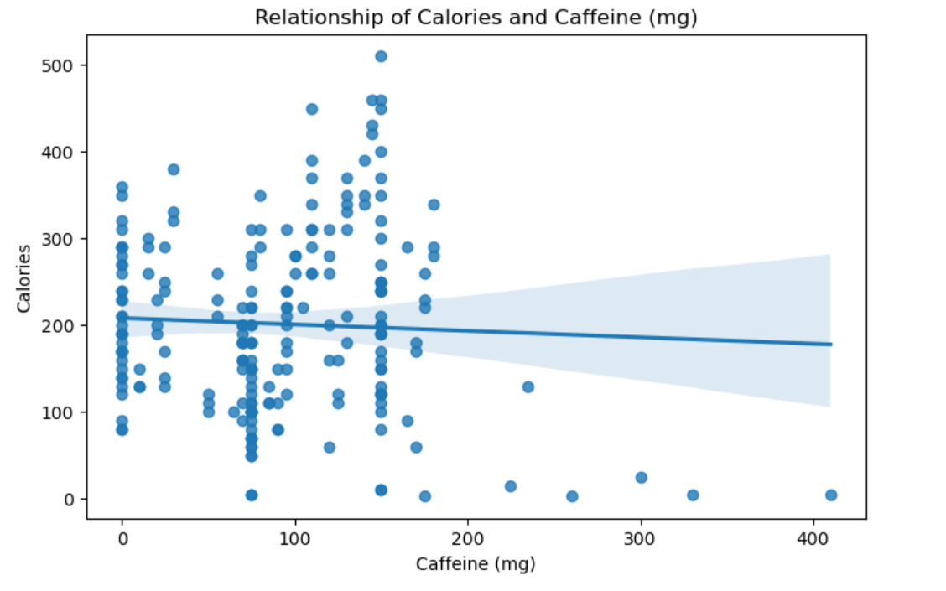
Relationship Relationship of Calories and Caffeine (mg)
The Figure shows a scatter plot titled "Relationship of Calories and Caffeine (mg)," highlighting a weak positive correlation between caffeine (0-400 mg) and calorie count (0-500). The trend line suggests that beverages with higher caffeine might have slightly higher calories, but the correlation is not strong.

Slide 23
CHALLENGES
The analysis of Starbucks' nutritional content faces three challenges:
Seasonal items and regional variations may not be fully captured, and outdated data can distort conclusions.
Findings may not be generalizable to other chains due to differing menus and nutritional criteria.
Variations in preparation and toppings can lead to inaccuracies in estimating actual consumption.

Slide 24
FUTURE SCOPE
Designing interactive digital tools, such as calorie counters linked with menu items, to assist users in customization as per their dietary requirements, increases engagement. The variety of food offerings, such as in vegan, gluten-free, and keto choices, is widened to appeal to customers who are health-conscious. Seasonal menus concentrate on fresh, locally sourced ingredients. A feedback mechanism through surveys or focus groups ensures customer feedback that drives improvement.

Slide 25
CONCLUSIONS
Visualizations reveal that different beverages contain varying nutrients, with Frappuccinos® being higher in sugar and carbs, and Tazo® Tea Drinks having more fiber. This helps customers choose drinks based on nutritional value.
By offering health-focused menu options and interactive nutritional tools, Starbucks enhances its commitment to transparency and health. Implementing robust customer feedback systems will help Starbucks adapt to changing needs, boost consumer confidence, and reinforce its role as a leader in health and wellness.

Slide 26
REFERENCES
[1] C. Huang, T. Dumanovsky, L. D. Silver, C. Nonas, and M. T. Bassett, “Calories from beverages purchased at 2 major coffee chains in New York City, 2007,” Preventing Chronic Disease, vol. 6, no. 4, p. A118, Oct. 2009, Accessed: Mar. 30, 2024. [Online]. Available: https://pubmed.ncbi.nlm.nih.gov/19754994/
[2] Bollinger, Bryan, et al. Calorie Posting in Chain Restaurants. 1 Jan. 2010, https://doi.org/10.3386/w15648 . Accessed 23 May 2023.
[3] Wu, A. & Mission San Jose High School. (2018). Starbucks Coffee statistical analysis. In Proceedings of the International Conference on Industrial Engineering and OperationsManagement. https://www.ieomsociety.org/paris2018/papers/424.pdf
[4] M. Kim, B. -T. Zhang and J. -S. Lee, "Dynamic and Static Influence Models on Starbucks Networks," 2009 International Conference on Advances in Social Network Analysis and Mining, Athens, Greece, 2009, pp. 344-347, doi:10.1109/ASONAM.2009.50.
[5] M. Kim, B. -T. Zhang and J. -S. Lee, "Social Influence Models Based on Starbucks Networks," 2009 International Conference on Computational Aspects of Social Networks, Fontainebleau, France, 2009, pp. 3-9, doi: 10.1109/CASoN.2009.26.
[6] R. Sarki and Y. -M. Kwon, "Towards buying experience with things: Experimental study @Starbucks," 2015 17th International Conference on Advanced Communication Technology (ICACT), PyeongChang, Korea (South), 2015, pp. 267-270, doi: 10.1109/ICACT.2015.7224800.

Slide 27
[7] Han, X., Ren, J., Caloric Restriction and Heart Function: Is There a Sensible Link?, NCBI, Available: https://ww.ncbi.nlmnih.gov/pmc/articles/PMC4002317/
[8] Jephcote, B., The More Carbs You Eat, the Higher the Risk of Heart Disease, Diabetes.co, Available: https://www.diabetes.co.uk/in-depth/carbs-higher-risk-heart-disease-states-leading-cardiologist-dr-salimyusuf/ February 20, 2017.
[9] Shmerling, R., Sodium Studies Blur the Picture on What is Heart Healthy, Harvard Health Publishing, Available: https://www.health.harvard.edu/blog/sodium-studies-blur-picture-heart-healthy-20140815736 August15,2014. [10] Three to Four Cups of Coffee a Day Linked to Longer Life,ScienceDaily, Available https://www.sciencedaily.com/releases/2017/11/171122190659.html November 22, 2017.
[11] C. Huang, T. Dumanovsky, L. D. Silver, C. Nonas, and M. T. Bassett, “Calories From Beverages Purchased at 2 Major Coffee Chains in New York City, 2007,” Preventing Chronic Disease, vol. 6, no. 4, p. A118, Sep. 2009, Available: https://www.ncbi.nlm.nih.gov/pmc/articles/PMC2774632/
[12] “Nutrition by the Cup.” Available: https://stories.starbucks.com/uploads/2019/01/nutrition-1.pdf
[13] S. Berinato, “Calorie Labeling at Starbucks (727 Words, 6 Minutes to Read),” Harvard Business Review, Feb. 04, 2010. https://hbr.org/2010/02/starbucks-calories
[14] R. J. Avery, J. Cawley, J. Eddelbuettel, M. D. Eisenberg, C. Mann, and A. D. Mathios, “Consumer Responses to Firms’ Voluntary Disclosure of Information: Evidence from Calorie Labeling by Starbucks,” SSRN Electronic Journal, 2021, doi: https://doi.org/10.2139/ssrn.3893361.
[15] V. Nguyen, O. Alstott, D. Sanders, L. Beveridge, and L. Du, “Health Trends and Their Effects On Consumers’ Starbucks Order Decisions INTRODUCTION AND BACKGROUND.” Accessed: May 08, 2024. [Online]. Available: https://theolivealstott.wordpress.com/wp-content/uploads/2019/06/health-trends-and-their-effects-on-consumerse28099-starbucks-order-decisions.pdf
[16] “Healthiest Starbucks Drinks and Food,” Verywell Fit. https://www.verywellfit.com/starbucks-how-to-order-low-calorie-coffee-drinks-3495691
[17] N. Geereddy, “Strategic Analysis of Starbucks Corporation,” 2023. Available: https://scholar.harvard.edu/files/nithingeereddy/files/starbucks_case_analysis.pdf
‌

Slide 28
THANK YOU !

